Slide 1




Covid 19
Data analytics project
Presented By Dr Doaa Hussein

Slide 2


Contents of analysis
01
02
03
Death ratio relative to the active
Total death in each status
Discharge ratio in each zone
04
05
06
Cases relative to the total population
Cases relative to the death ratio
Cases relative to the discharge ratio

Slide 3


Our case study insights
Out of a total population of 1,429,869,880, approximately: 3% (42,896,096) died2% (28,597,398) were discharged0.01% (142,987) remain active cases
Kerala reported the highest number of cases, while Maharashtra recorded the highest number of deaths.
East zone reported the highest discharge ratio( 1276.5)

Slide 4

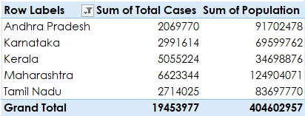
Total cases relative to the population in top 5 status
Instruments
Equipment
Protection and security

Slide 5


Slide 6
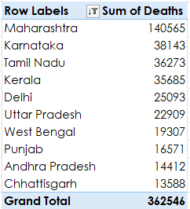
Total death in each status
Instruments
Equipment
Protection and security

Slide 8
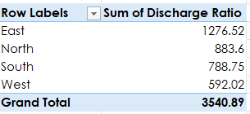
Discharge ratio in each zone
Instruments
Equipment
Protection and security

Slide 10
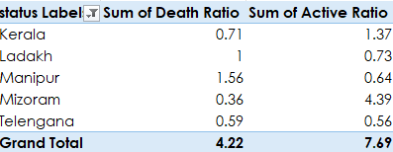
Death ratio relative to the active ratio in the top 5 states
Instruments
Equipment
Protection and security

Slide 12
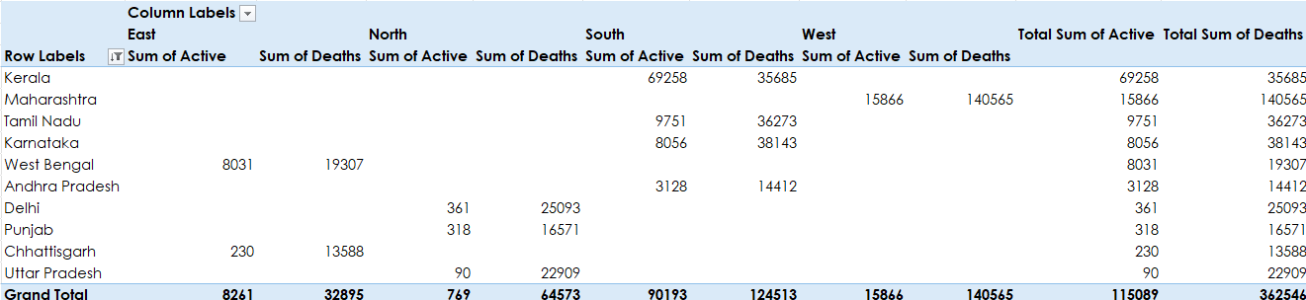
States and zones death relative to the active cases
Instruments
Equipment
Protection and security

Slide 14

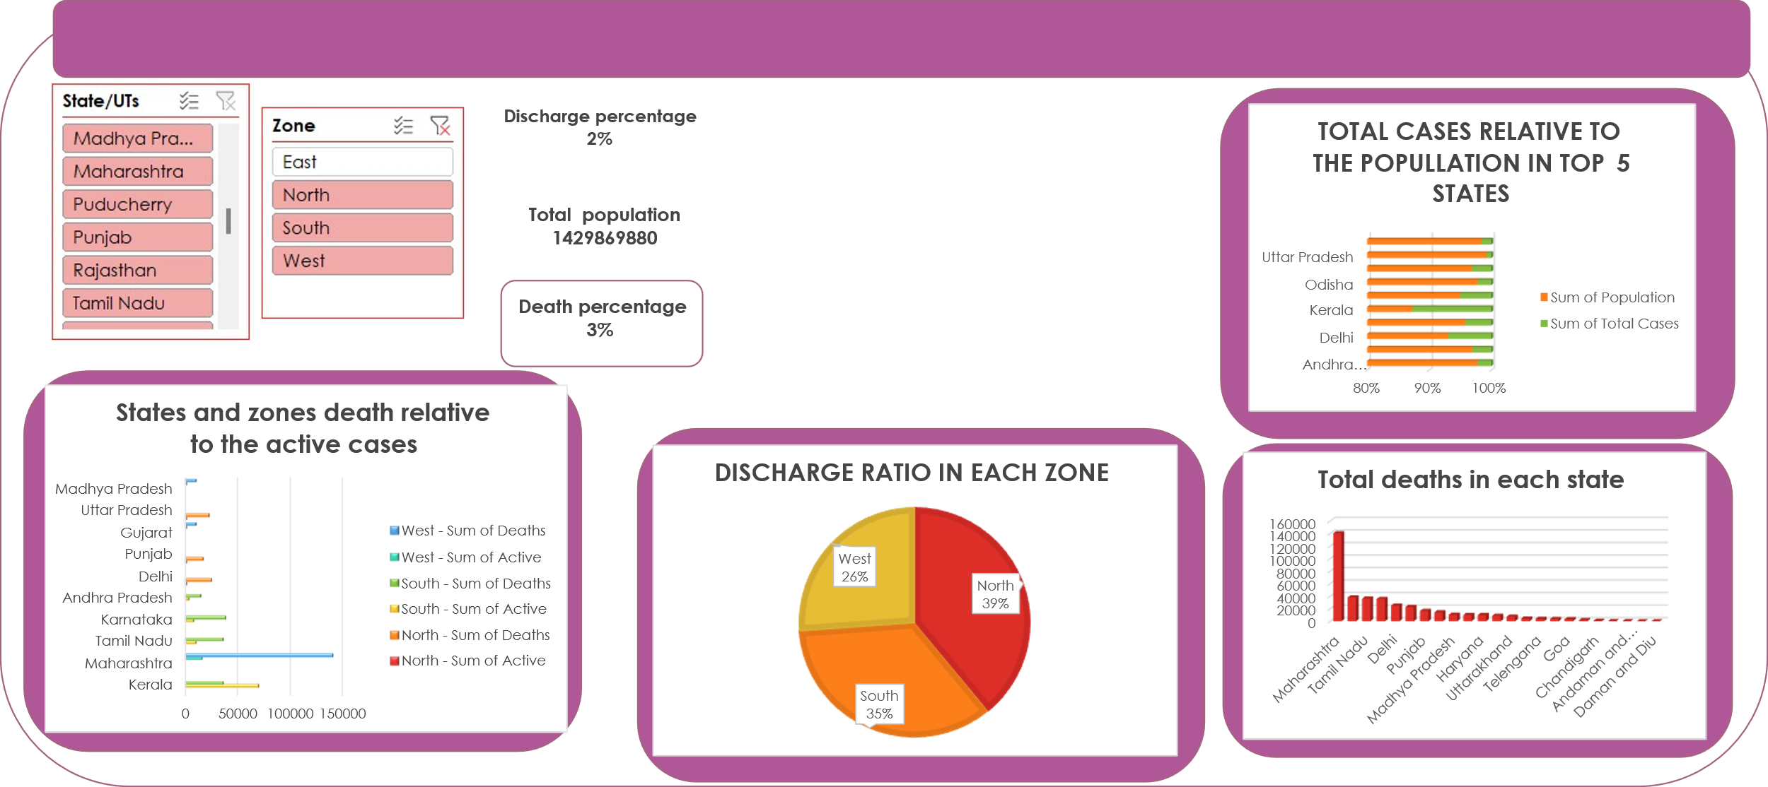

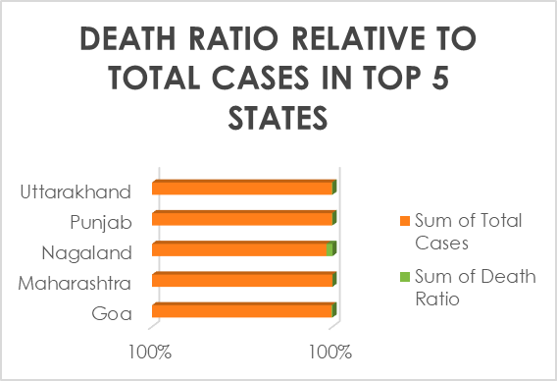
Covid cases report

Slide 15

THANK YOU!

